Slide 1
Introduction to Python for Image Processing
Instructor:
Junyu Chen (Day1 & Day2)
Prof. Marvin Doyley (Day3)

Slide 2

Self-intro
B.S. in Psychology. Peking University
B.A. in Economics. Peking University
M.S. in Data Science. University of Rochester
Incoming Ph.D. student. UR CS
Email: jchen175@ur.rochester.edu
Junyu Chen
Notes:
Welcome! I'm Junyu Chen, your instructor for this summer school course on Python basics and basic image processing. I have a background in Psychology, Economics, and Data Science, and I am an incoming Ph.D. student in Computer Science department at the University of Rochester, I'm excited to share my knowledge and passion for programming with all of you.
Don't worry if you have no coding experience before. We will start from the very basics, gradually building our understanding of Python's syntax, data types, control structures, and functions.
By the end of this course, you will feel confident in writing Python code and applying it to basic image processing task.

Slide 3
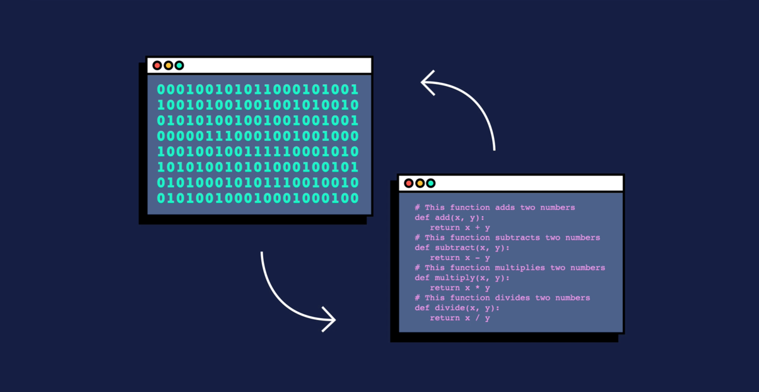
What is programming?
Process of designing, writing, and maintaining code
Set of instructions for a computer, written using programming languages
Primary purpose: solve problems and create software
Automate tasks, process data, develop systems
Communicate with computers
Create efficient solutions
...
https://www.codecademy.com/resources/blog/programming-languages/
Notes:
Let's get started. Programming, in simple terms, is the art of giving instructions to a computer to perform specific tasks.
It's a language that allows us to communicate with machines and make them do what we want.
Imagine that you have a personal assistant who doesn't understand human language but comprehends a special code language.
Programming is similar to speaking this code language, providing step-by-step instructions for computers to execute tasks.

Slide 4
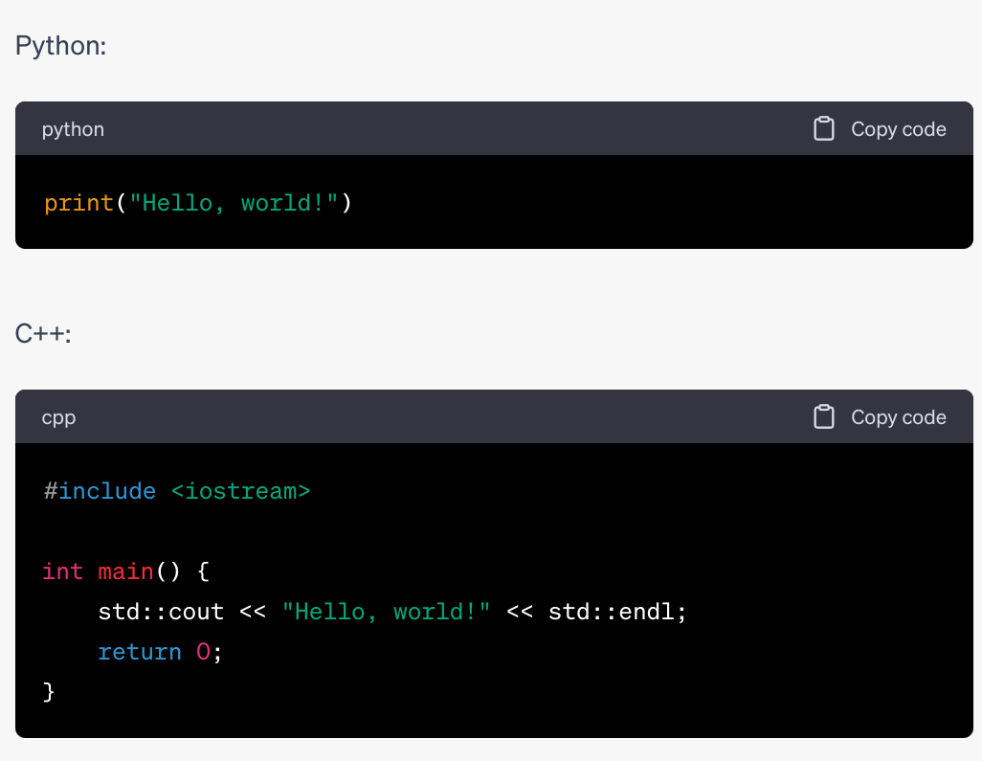
Why Python?
Easy to learn and readable syntax
Versatile and multi-purpose
Extensive libraries and packages
collections of pre-written code that can be used to perform specific, so you don’t have to start from scratch
Web development (Django, Flask)
Data analysis (Pandas, NumPy)
Machine learning (TensorFlow, PyTorch)
Image processing (OpenCV, skimage)
...
Cross-platform compatibility
Strong community support
High demand in the job market
Notes:
So why we would use python.
Firstly, Python is known for its simplicity and readability. Its clean syntax and intuitive structure make it easier for beginners to grasp and understand.
This simplicity allows learners to focus on problem-solving rather than getting lost in complex language details.
By the way, here is how we do the classic hello world stuff in Python and C-plus-plus.
Secondly, Python boasts a vast and supportive community. Countless resources, tutorials, and libraries are available to assist beginners in their learning journey. This vibrant community provides a nurturing environment for beginners to seek help, exchange ideas, and collaborate on projects.
Additionally, Python is widely used in the industry such as web development, data analysis, AI. Due to this there are many resources, tutorials, and libraries available online. After you know the basic stuff about python, you can easily use other pre-fined packages for real-life applications. it also has some other benefits like Cross-platform compatibility, and Strong community support. And it is also an important skill if you want to find a tech job.

Slide 5
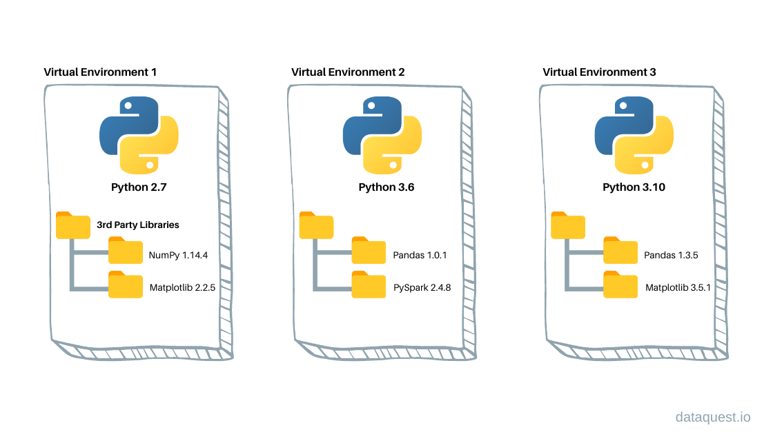
Python Environment with Anaconda
Python environment
Python interpreter and runtime
Collection of packages and libraries
Customized settings and configurations
Benefits:
Dependency management: Each project may have its own specific set of packages and library versions.
Isolation: Environments provide isolation, preventing issues that may arise from different projects requiring incompatible versions of the same library or package.
Easier reproducibility
Easier collaboration
https://www.dataquest.io/blog/a-complete-guide-to-python-virtual-environments/
Notes:
So, let's first download a software and set up the environment, so that we can run Python codes on the computer.
A Python environment is where we work with Python code, and it's essential for a few reasons.
Firstly, it provides an interpreter to execute Python code line by line. This allows us to see the immediate results of our code.
Secondly, a Python environment includes libraries and packages that extend Python's capabilities. These pre-written code blocks help with specific tasks, like data analysis or image processing.
Next, it offers an editor or IDE to write and edit Python code comfortably. These tools have features like highlighting and autocompletion to make coding easier.
Additionally, a Python environment helps manage different Python versions and dependencies required by our projects. It ensures our code works consistently across machines.
Lastly, a Python environment allows for reproducibility and collaboration. Others can run our code and get the same results, making teamwork and sharing easier.
In summary, a Python environment provides the necessary tools for coding, executing, and collaborating with Python. It includes an interpreter, libraries, an editor/IDE, version management, and facilitates reproducibility.

Slide 6
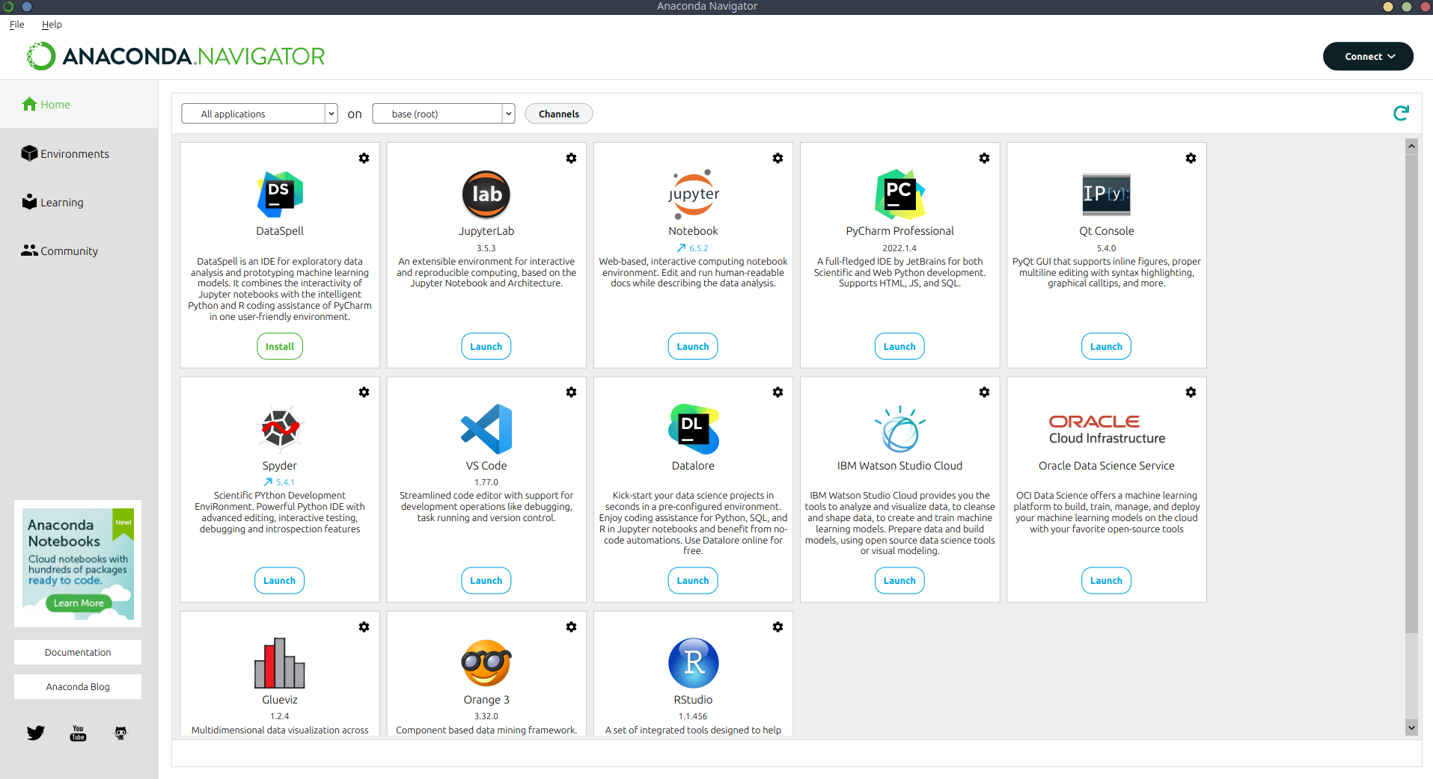
Python Environment with Anaconda
Anaconda
A popular Python distribution that simplifies setting up Python environments, package management, and data science tools.
Anaconda Navigator
A graphical user interface that helps beginners manage environments, packages, and launch applications like Jupyter Notebook and Spyder IDE without needing to use command-line tools.
The interface of Anaconda Navigator
Notes:
In this course, we will be using Anaconda Navigator to set up our Python environment.
Anaconda Navigator is a user-friendly graphical interface that simplifies the management of Python packages, environments, and applications.

Slide 7
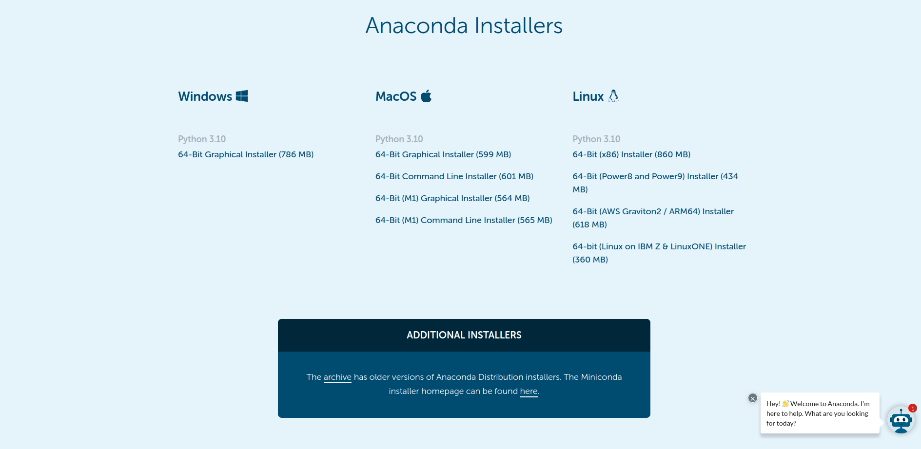
Python Environment with Anaconda
Install Anaconda Navigator
Download link: https://www.anaconda.com/products/distribution#Downloads
Tutorial: https://docs.anaconda.com/anaconda/install/
Notes:
Let’s first get anaconda installed on our machines.
Just open a browser and google anaconda and then follow the prompt to get it installed. You can use the default setting during the installation process. Let me know if you run into any problems.

Slide 8
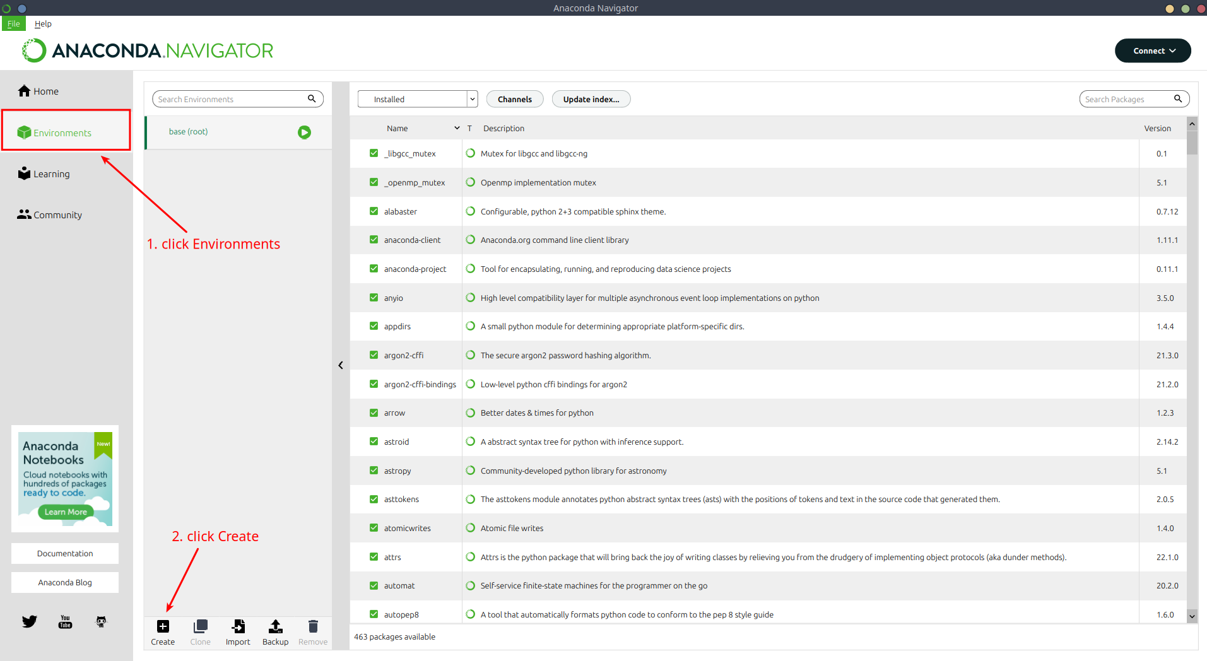
Python Environment with Anaconda
Notes:
Now I think everyone has got anaconda installed, let's create our first Python environment. Here are the basic steps.

Slide 9
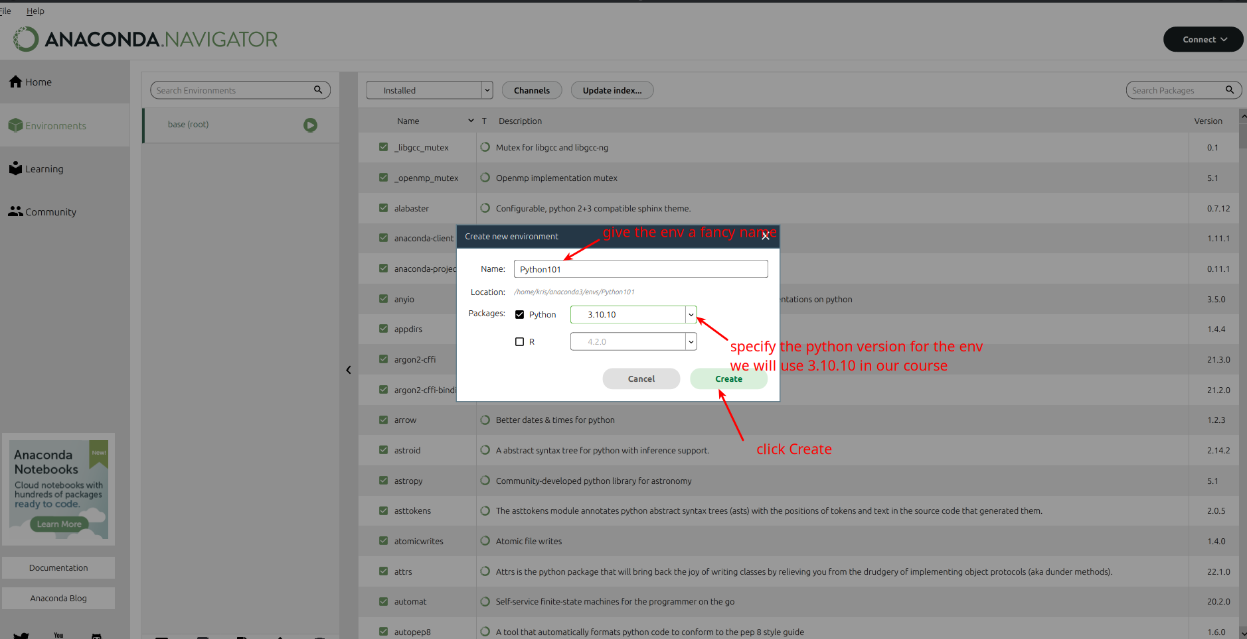
Python Environment with Anaconda

Slide 10
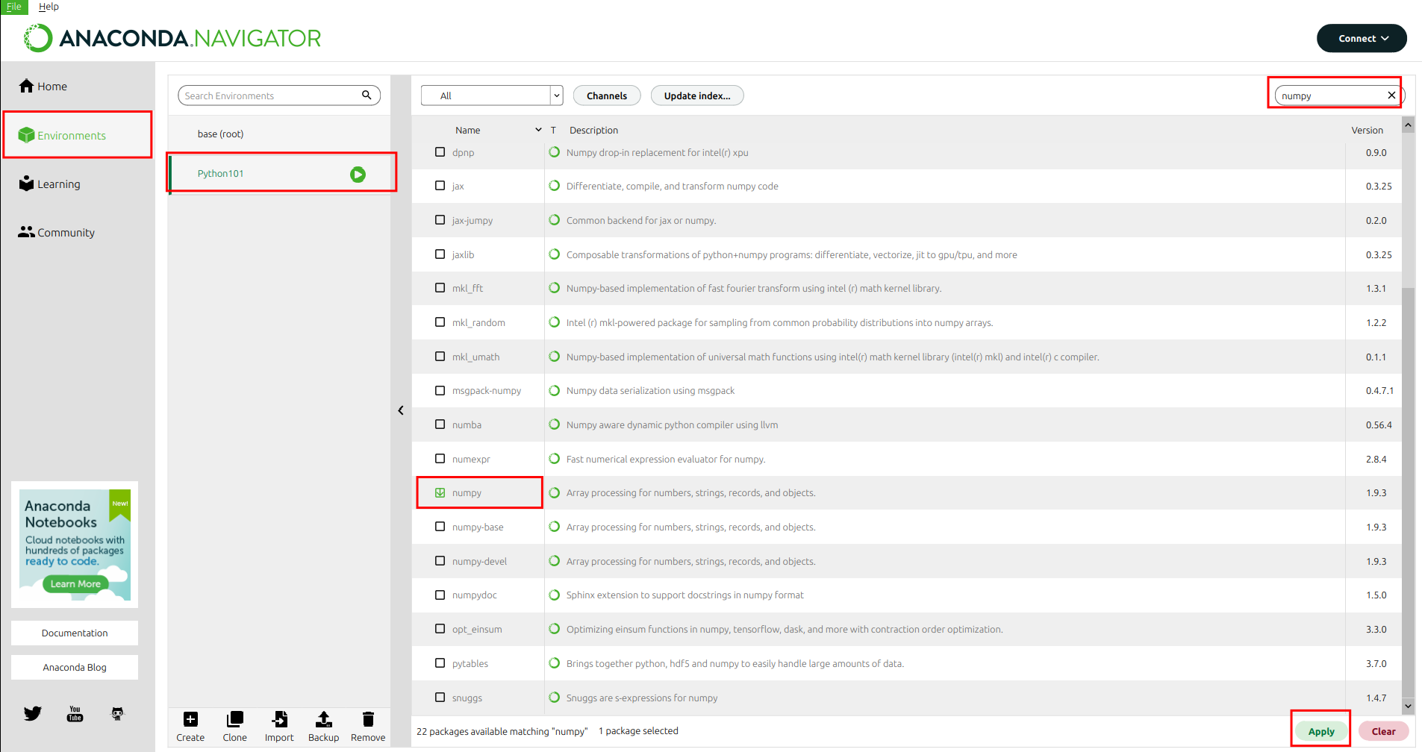
Python Environment with Anaconda
Install packages in an environment

Slide 11
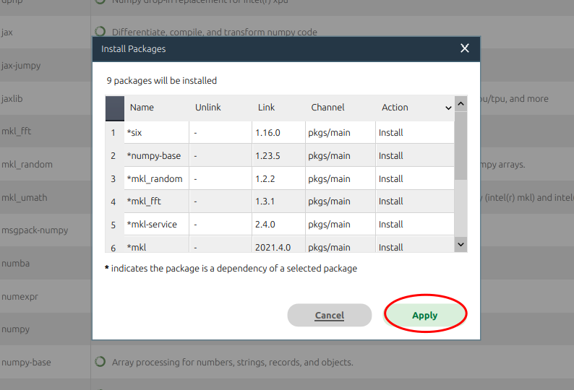
Python Environment with Anaconda
Notes:
This is an example about how to use anaconda to set up environment and We will learn more about how to use these pre-defined packages later.

Slide 12
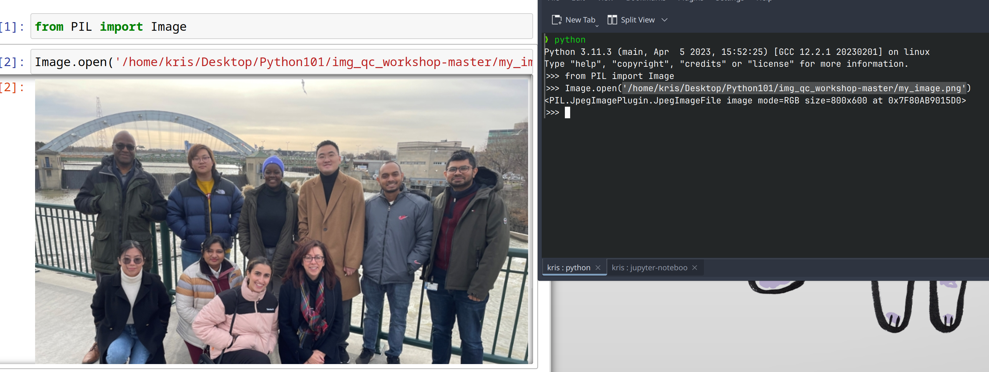
Python Environment with Anaconda
Jupyter Notebook
Interactive coding: write and execute code in an interactive manner
Visualization: support the visualization of data using libraries like Matplotlib and Seaborn
Notes:
Now let's introduce another important tool which is Jupyter notebook.
Jupyter Notebook is an interactive computing environment that allows you to create and share documents containing live code, equations, visualizations, and narrative text.
It's a powerful tool for data analysis, experimentation, and collaborative work, providing an intuitive interface for writing codes.
For example, if you run codes in terminal, it would be very difficult to do some visualization. But in Jupyter it is a implemented feature and you can do the visualization smoothly.

Slide 13
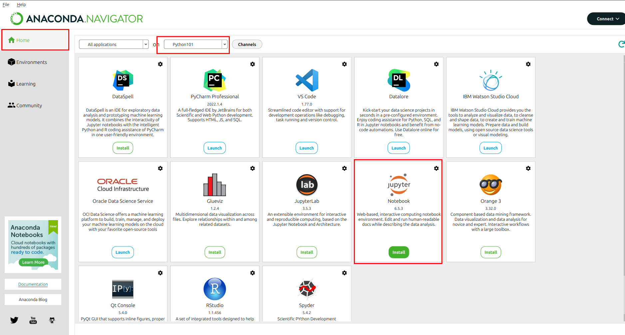
Python Environment with Anaconda
Notes:
Here is how to install the Jupyter. Remember you need to first change the env to the correct one.

Slide 14
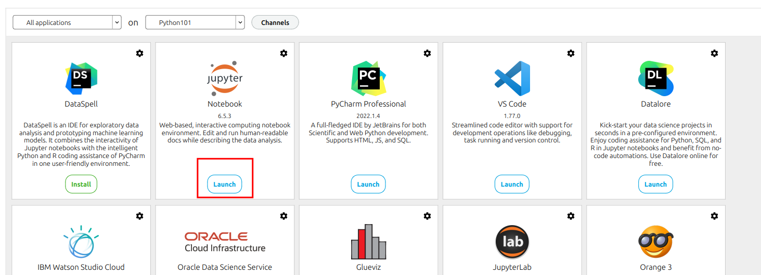
Python Environment with Anaconda

Slide 15
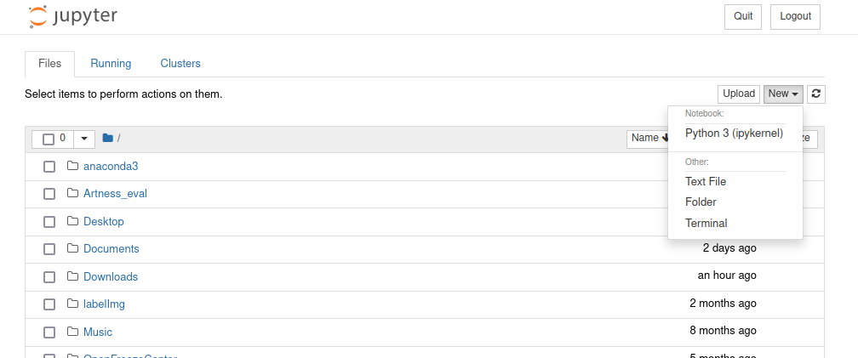
Python Environment with Anaconda
Notes:
You can first create

Slide 16
Python Environment with Anaconda

Slide 17
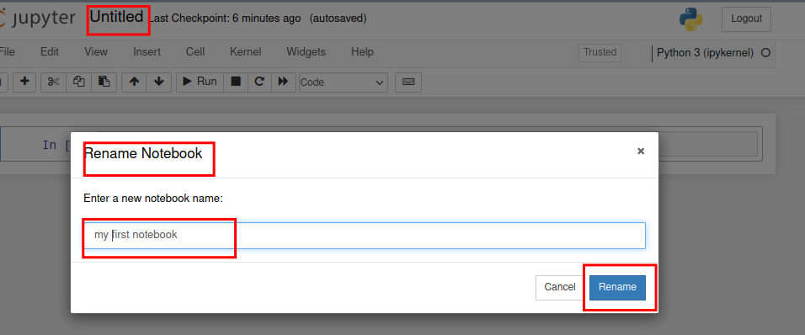
Python Environment with Anaconda
Notes:
add predefined lib

Slide 18
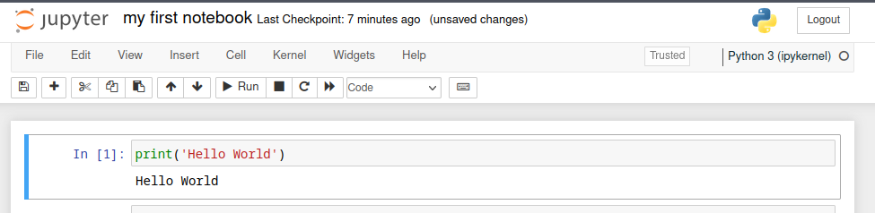
Python Environment with Anaconda

Slide 19
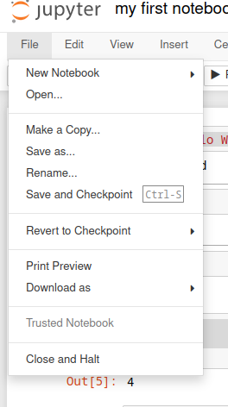
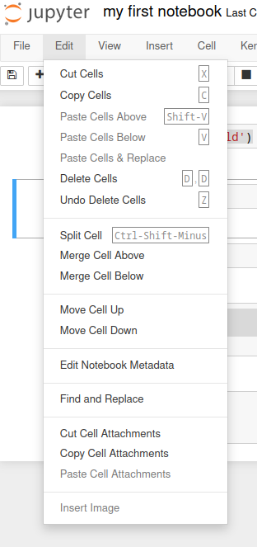
Python Environment with Anaconda

Slide 20
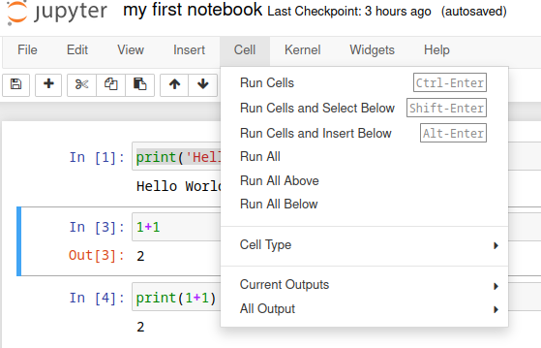
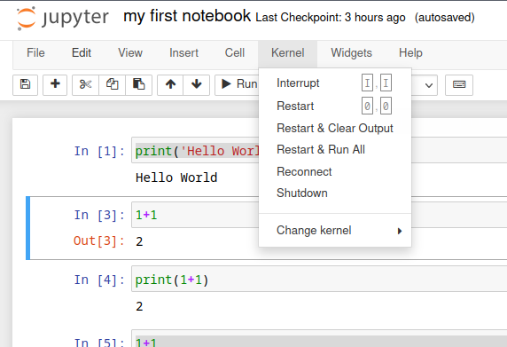
Python Environment with Anaconda

Slide 21
Exercise
Create a new notebook by clicking on "New" and selecting "Python 3" kernel.
In the first cell, enter print('hello world'), then execute the cell by pressing Shift + Enter or by clicking the "Run" button.
In the second cell, try to get the result of the following equation: 5 + 3 * 2
Save the checkpoint by clicking on "File" and selecting "Save and Checkpoint" or by using the keyboard shortcut Ctrl + S.
Delete all cells by selecting "Edit" from the menu and choosing "Delete All Cells".
To recover to the previous saved checkpoint, click on "File" and select "Revert to Checkpoint". Confirm the revert action when prompted.

Slide 22
Python Basics
Notes:
Let's talk about some python basics

Slide 23
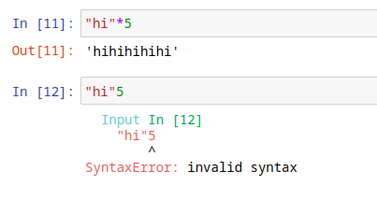
Primitive Constructs and Syntax
primitive constructs
English: words
programming language: numbers, strings, simple operators
syntax
English:
"cat dog boy" → not syntactically valid
"cat hugs boy" → syntactically valid
Python:
"hi"5 → not syntactically valid
3.2*5 → syntactically valid
Credit: Ana Bell, Eric Grimson, John Guttag (2016). Introduction to Computer Science and Programming in Python [PowerPoint slides].
Notes:
In programming, primitive constructs refer to the fundamental data types provided by the language.
Python has several built-in primitive data types, including: Integers, Floats, Strings, simple operators, loops
They are similar to words in English.
To combine these constructs into an expression that machine can understand.
We have to follow the python syntax, which refers to the rules and structure of the programming language.
For example, if the interpreter can't understand what an expression means, it would raise a syntax error.

Slide 24
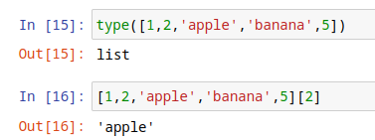
Objects
programs manipulate data objects
objects have a type that defines the kinds of things programs can do to them
Ana is a human so she can walk, speak, etc.
objects are
scalar (cannot be subdivided)
non-scalar (have internal structure that can be accessed)
Credit: Ana Bell, Eric Grimson, John Guttag (2016). Introduction to Computer Science and Programming in Python [PowerPoint slides].
Notes:
Another important concept is object.
Object represents a unique entity that encapsulates both data (attributes) and behavior (methods).
In Python, almost everything is an object.
This refers to the fact that even built-in data types (like integers, strings, lists) and language constructs (like functions, modules, and classes) are implemented as objects.
We will understand more about this concept after we cover the basic data types

Slide 25
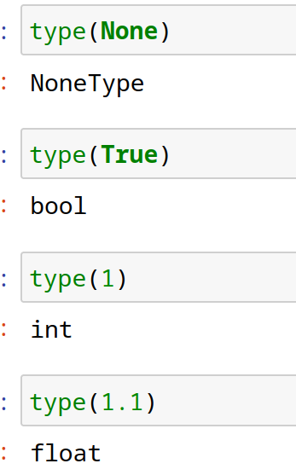
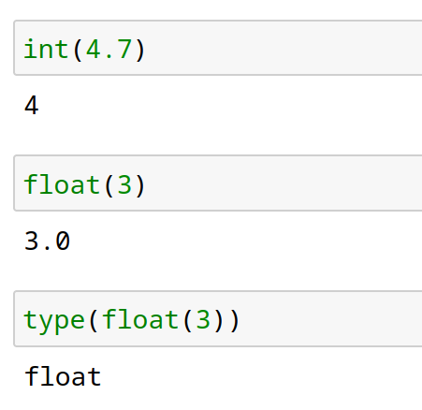
Scalar Objects
int – represent integers, eg. 5
float – represent real numbers, eg. 3.27
bool – represent Boolean values True and False
NoneType – special and has one value, None
can use type() to see the type of an object
can convert object of one type to another
float(3) converts integer 3 to float 3.0
int(3.9) truncates float 3.9 to integer 3
Credit: Ana Bell, Eric Grimson, John Guttag (2016). Introduction to Computer Science and Programming in Python [PowerPoint slides].
Notes:
In Python, scalar objects are a type of data that represents a single value. They are simple, indivisible entities that cannot be further broken down into smaller components.
Let's explore some of the common scalar object types in Python:
Integers: Integers represent whole numbers without any fractional or decimal part. For example, 1, 10, -5 are all integer values.
Floats: Floats are used to represent decimal numbers or numbers with a fractional part. For example, 3.14, -0.5, 2.0 are float values.
Booleans: Booleans represent logical values of either True or False. They are used for making decisions and controlling the flow of a program. Boolean values help determine the truth or falsity of conditions.
None: None is a special scalar object that represents the absence of a value. It is commonly used to indicate that a variable or expression does not have a meaningful value assigned to it.

Slide 26
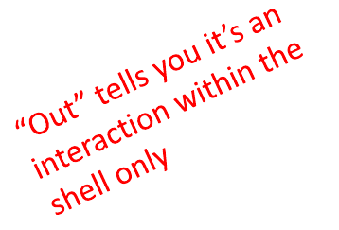
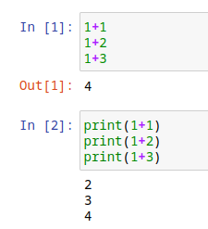
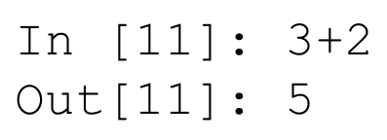
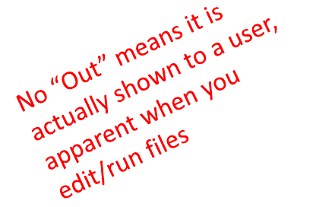
Printing to Console
to show output from code to a user, use print command
Credit: Ana Bell, Eric Grimson, John Guttag (2016). Introduction to Computer Science and Programming in Python [PowerPoint slides].
Notes:
I think I should mention this to help you debug.
to show output from code to a user, use print command.
For example, if you run multiple expressions within a cell, it would probably only shown the last result unless you explicitly ask it to print the result

Slide 27
Expressions
combine objects and operators to form expressions
an expression has a value, which has a type
syntax for a simple expression
<object> <operator> <object>
Credit: Ana Bell, Eric Grimson, John Guttag (2016). Introduction to Computer Science and Programming in Python [PowerPoint slides].
Notes:
Here is the concept of expressions, which combine objects and operators
an expression has a value, which has a type
For example one plus one is a simple expression

Slide 28
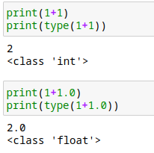
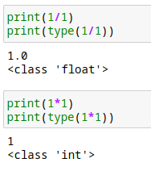
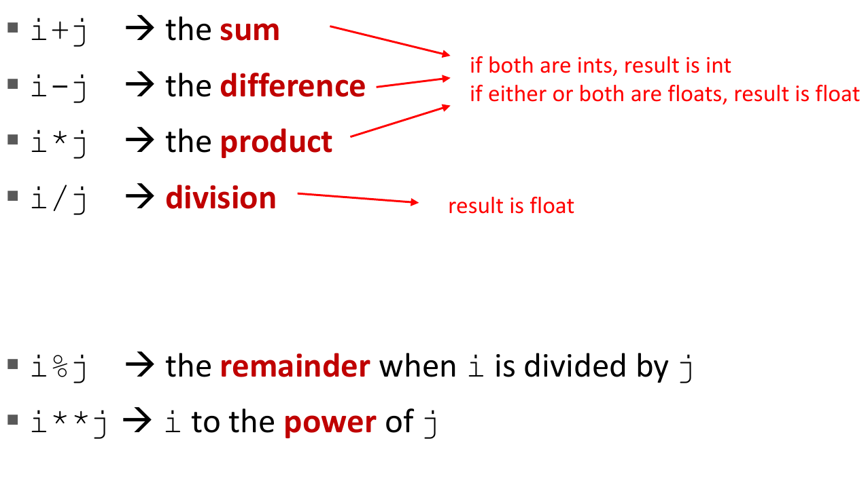
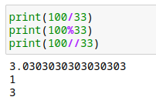
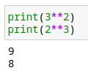
Operations on ints and floats
syntax for a simple expression
<object> <operator> <object>
Credit: Ana Bell, Eric Grimson, John Guttag (2016). Introduction to Computer Science and Programming in Python [PowerPoint slides].
Notes:
Here are some more examples about Operations on ints and floats
You may try these codes in your jupyter notebook
You may need to remember the meaining of these three signs:
Percentage sign: Modulo Operator (%): The modulo operator % is used to obtain the remainder of a division operation. It returns the remainder after dividing the left operand by the right operand.
double slash: Floor Division Operator (//): The floor division operator // is used to perform division between two numbers and obtain the quotient as an integer, discarding the fractional part
Double star: is the power operator

Slide 29
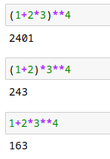
Simple Operations
parentheses used to tell Python to do these operations first
operator precedence without parentheses
**
*
/
+ and - executed left to right, as appear in expression
Credit: Ana Bell, Eric Grimson, John Guttag (2016). Introduction to Computer Science and Programming in Python [PowerPoint slides].
Notes:
Note that the order, or priority of operators are similar to what we use in mathematics.
Also like in mathematics, you can also change the order with parentheses.

Slide 30
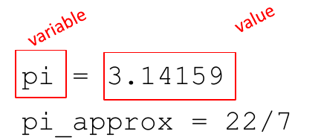
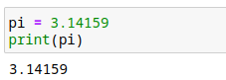
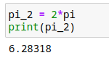
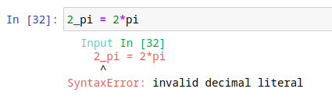
Binding Variables and Values
equal sign is an assignment of a value to a variable name
value stored in computer memory
an assignment binds name to value
retrieve value associated with name or variable by invoking the name, by typing pi
Credit: Ana Bell, Eric Grimson, John Guttag (2016). Introduction to Computer Science and Programming in Python [PowerPoint slides].
Notes:
Now let’s talk about variable.
In Python, a variable is a named reference to a value or an object in memory.
It acts as a container that holds a specific data value or object.
Variables allow you to store and manipulate data, making your code more dynamic and flexible.
Assignment: Variables are assigned using the assignment operator (=). The value on the right side of the operator is stored in the variable on the left side. You can assign new values to variables as needed, even changing the type of the stored value.

Slide 31
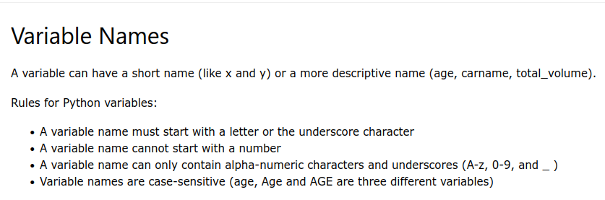
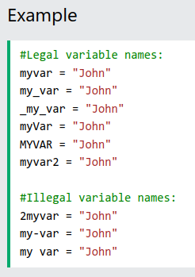
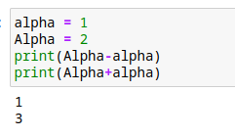
Binding Variables and Values
Credit: https://www.w3schools.com/python/gloss_python_variable_names.asp
Notes:
Here is the rule of variable names.
Variable names can consist of letters (both uppercase and lowercase), digits, and underscores.
However, they cannot start with a digit.
It's recommended to use descriptive names that reflect the purpose or meaning of the stored value.

Slide 32
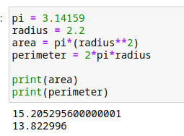
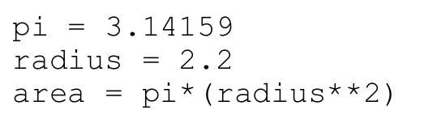
Abstracting Expressions
why give names to values of expressions?
to reuse names instead of values
easier to change code later
Credit: Ana Bell, Eric Grimson, John Guttag (2016). Introduction to Computer Science and Programming in Python [PowerPoint slides].
Notes:
why give names to values of expressions?
to reuse names instead of values
easier to change code later

Slide 33
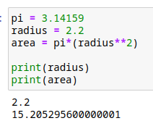
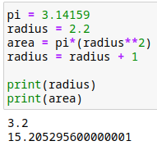
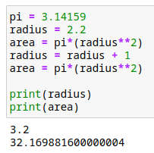

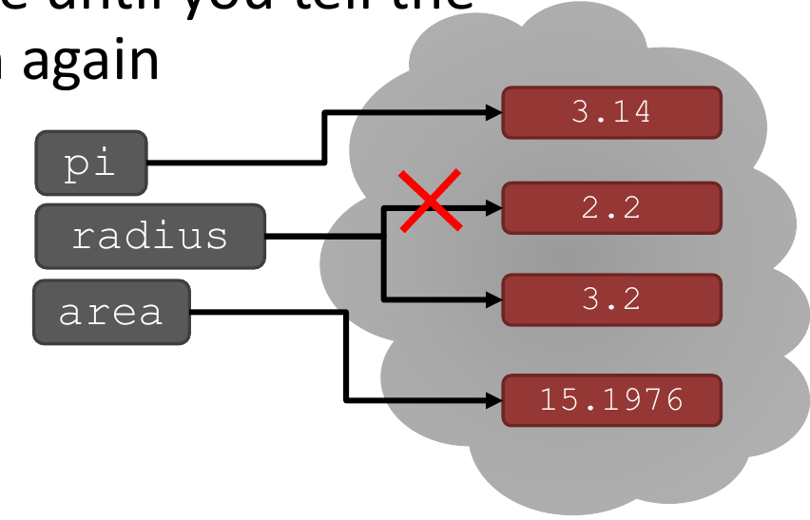
Changing Bindings
can re-bind variable names using new assignment statements to reuse names instead of values
previous value may still store in memory but lost the handle for it
value for area does not change until you tell the computer to do the calculation again
Credit: Ana Bell, Eric Grimson, John Guttag (2016). Introduction to Computer Science and Programming in Python [PowerPoint slides].
Notes:
can re-bind variable names using new assignment statements to reuse names instead of values
previous value may still store in memory but lost the handle for it
Like the example shown here, if you use another assignment statement to give radius a new value, it would change accordingly.
However, the value for area does not change until you tell the computer to do the calculation again

Slide 34
Exercise: Variable Types and Binding
Declare a variable called my_variable and assign an integer value of your choice to it.
Print the value of my_variable to the console.
Reassign a different value of a different data type to my_variable.
Print the updated value of my_variable to the console.
Declare another variable called new_variable and assign a string value to it.
Print the value of new_variable to the console.
Swap the values of my_variable and new_variable using a temporary variable.
Print the values of my_variable and new_variable after the swap

Slide 35
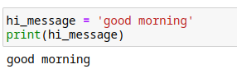
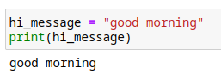
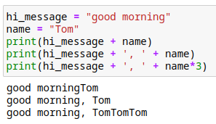
String objects
letters, special characters, spaces, digits
enclose in quotation marks or single quotes
concatenate strings
do some operations on a string as defined in Python docs
Credit: Ana Bell, Eric Grimson, John Guttag (2016). Introduction to Computer Science and Programming in Python [PowerPoint slides].
Notes:
In Python, a string is a sequence of characters enclosed within single quotes ('') or double quotes (""). Strings are used to represent text and are one of the most commonly used data types in Python. Here are some basic operations and concepts related to strings:
String Creation: You can create a string by enclosing characters within quotes. For example: my_string = "Hello, Python!"
String Concatenation: Strings can be concatenated (joined together) using the + operator. This operation combines two or more strings into a single string. For example:
first_name = "John" last_name = "Doe" full_name = first_name + " " + last_name
String Length: The len() function returns the length (number of characters) of a string. For example:
message = "Hello, world!" length = len(message)
String Indexing: Each character in a string has an index, starting from 0 for the first character. You can access individual characters using indexing. For example:
message = "Hello" first_character = message[0]
String Slicing: You can extract a substring from a string using slicing. Slicing allows you to obtain a portion of a string by specifying the start and end indices. For example:
message = "Hello, world!" substring = message[7:12] # Extracts "world"
String Formatting: String formatting allows you to create dynamic strings by inserting values into placeholders. The format() method is commonly used for string formatting. For example:
name = "Alice" age = 25 greeting = "My name is {} and I'm {} years old.".format(name, age)
String Methods: Python provides a variety of built-in methods to manipulate and transform strings. Some commonly used methods include upper(), lower(), strip(), split(), replace(), and find(). For example:

Slide 36
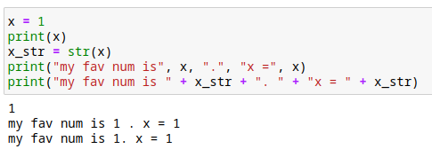



INPUT/OUTPUT: print
used to output stuff to console
keyword is print
f and {}: embed variable into a string
Tab: autocomplete
after you hit tab:
Credit: Ana Bell, Eric Grimson, John Guttag (2016). Introduction to Computer Science and Programming in Python [PowerPoint slides].
Notes:
Here are some other stuffs. There are some ways if you want to print a string and some other types of variables together.

Slide 37





INPUT/OUTPUT: input(" ")
prints whatever is in the quotes
user types in something and hits enter
binds that value to a variable
input gives you a string so must cast if working with numbers
Credit: Ana Bell, Eric Grimson, John Guttag (2016). Introduction to Computer Science and Programming in Python [PowerPoint slides].
Notes:
The input() function is a built-in function in Python that allows you to interact with the user by taking input from them during program execution. It enables you to prompt the user for input and store the entered value for further processing.
Here's a brief introduction to the input() function:
The input() function works by displaying a prompt to the user, typically in the form of a question or instruction. The program then waits for the user to enter a value from the keyboard. Once the user enters their input and presses the Enter key, the input() function reads the input and returns it as a string.

Slide 38

Comments
explain what a piece of code does, provide context, or add notes to the code for other programmers to understand
ignored by the Python interpreter, which means they do not affect the execution of the code
single-line comments start with a hash symbol (#)
Multi-line comments are enclosed in triple quotes (''' or """)
Credit: Ana Bell, Eric Grimson, John Guttag (2016). Introduction to Computer Science and Programming in Python [PowerPoint slides].
Notes:
In Python, comments are lines of code that are not executed by the interpreter.
They are used to provide explanations, add notes, or temporarily disable specific parts of the code.
Comments are ignored by the Python interpreter and serve as documentation for developers or other readers of the code.
Here's an introduction to comments in Python
Single-line comments
Multiple-line comments
Commenting out code

Slide 39


Comparison operators on int, float, string
i and j are variable names
comparisons below evaluate to a Boolean
Credit: Ana Bell, Eric Grimson, John Guttag (2016). Introduction to Computer Science and Programming in Python [PowerPoint slides].
Notes:
In Python, comparison operators are used to compare values and determine the relationship between them. They return a Boolean value (True or False) based on the comparison result.
Some of the comparisons are straightforward. You need to pay attention to the following two:
Equality (==): The equality operator checks if two values are equal. It returns True if the values are equal and False otherwise.
Inequality (!=): The inequality operator checks if two values are not equal. It returns True if the values are different and False if they are equal
Comparison operators are commonly used in conditional statements, loops, and sorting algorithms to make decisions or determine the order of elements.
They allow you to compare values of different data types and make logical comparisons in your Python programs.

Slide 40
Exercise: Comparison and String Operations
Prompt the user to enter two numbers (num1 and num2) of any data type (integers or floats).
Using the input values, perform the following tasks:
Print the sum of num1 and num2.
Check if num1 is equal to num2 and print the result.
Check if num1 is greater than num2 and print the result.
Convert num1 and num2 to strings and concatenate them.
Print the length of the concatenated string.
Prompt the user to enter two strings (str1 and str2).
Using the input values, perform the following tasks:
Check if str1 is equal to str2 and print the result.
Check if str1 is greater than str2 and print the result.
Concatenate str1 and str2.
Print the length of the concatenated string.

Slide 41



Control flow - branching
<condition> has a value True or False
evaluate expressions in that block if <condition>is True
Credit: Ana Bell, Eric Grimson, John Guttag (2016). Introduction to Computer Science and Programming in Python [PowerPoint slides].

Slide 42



Control flow - branching
<condition> has a value True or False
evaluate expressions in that block if <condition>is True
Credit: Ana Bell, Eric Grimson, John Guttag (2016). Introduction to Computer Science and Programming in Python [PowerPoint slides].
Notes:
In Python, the if statement is used for implementing conditional execution, allowing your program to make decisions based on certain conditions.
It enables you to control the flow of your program by executing specific blocks of code only if certain conditions are met.
The basic syntax of an if statement is as follows:
The condition is an expression that evaluates to either True or False. If the condition is true, the code block within the if statement is executed. If the condition is false, the code block is skipped, and program execution continues to the next line after the if statement.
The code block following the if statement is indented (by hitting the tab key) and typically consists of one or more lines of code. It is important to maintain consistent indentation to indicate which lines of code are part of the if block.
The if statement can also be extended with else and elif (short for "else if") clauses to handle multiple conditions. Here's an example:

Slide 43


Indentation
matters in Python
how you denote blocks of code
Credit: Ana Bell, Eric Grimson, John Guttag (2016). Introduction to Computer Science and Programming in Python [PowerPoint slides].
Notes:
In Python, unlike many other programming languages, indentation plays a crucial role in determining the structure and execution of your code.
Python uses indentation to define blocks of code, and it relies on indentation to understand the structure of your program, such as those within an if statement.
Here's an example to illustrate the importance of indentation in an if statement:

Slide 44


= vs ==
Credit: Ana Bell, Eric Grimson, John Guttag (2016). Introduction to Computer Science and Programming in Python [PowerPoint slides].
Notes:
Equality: always remember to distinguish between equality statement and assignment statement! Use double equal sign to test the equality between two variables.

Slide 45
Exercise: Grade Classification
Write a Python program that prompts the user to enter their exam score and determines their grade based on the following conditions:
If the score is greater than or equal to 90, print "Grade: A"
If the score is between 80 and 89 (inclusive), print "Grade: B"
If the score is between 70 and 79 (inclusive), print "Grade: C"
If the score is between 60 and 69 (inclusive), print "Grade: D"
If the score is less than 60, print "Grade: F"

Slide 46

Control flow - Loops
Credit: Ana Bell, Eric Grimson, John Guttag (2016). Introduction to Computer Science and Programming in Python [PowerPoint slides].
Notes:
In Python, loops are used to repeat a specific block of code multiple times, allowing you to automate repetitive tasks and iterate over collections of data.
This is an example why we need loop. Now, suppose we want to design a maze in a game. The character can leave this scene only if he choose to leave from the left direction.
It would be painful if we use conditional statement to implement this control flow.

Slide 47

Control flow - while LOOPS
while <condition>:
<expression>
<expression>
...
<condition> evaluates to a Boolean
if <condition> is True, do all the steps inside the while code block
check <condition> again
repeat until <condition> is False
Credit: Ana Bell, Eric Grimson, John Guttag (2016). Introduction to Computer Science and Programming in Python [PowerPoint slides].
Notes:
There are two main types of loops in Python: for loops and while loops. Let's explore each type and introduce the concept of loops in Python:
While Loops: A while loop is used to repeatedly execute a block of code as long as a certain condition is true.
It allows you to keep looping until the condition becomes false. The basic syntax of a while loop is as follows:
In this example, the while loop continues to execute the code block as long as the cur_num variable is less than or equal to 5.

Slide 48
Exercise: Comparison and String Operations
Write a Python program that prompts the user to create a new password.
The program should then allow the user to input the password up to 5 times.
If the entered password matches the newly created password, display a success message (hint: the loop can be terminated with the break statement).
Otherwise, provide feedback indicating the number of attempts remaining.
Notes:
new_password = input("Create a new password: ")
attempt_count = 5
while attempt_count > 0:
entered_password = input("Enter your password: ")
if entered_password == new_password:
print("Success! Password accepted.")
break
else:
attempt_count -= 1
if attempt_count > 0:
print("Invalid password. You have", attempt_count, "attempt(s) remaining.")
else:
print("Invalid password. No attempts remaining. Access denied.")

Slide 49



Control flow - while and for LOOPS
iterate through numbers in a sequence
for <variable> in range(<some_num>):
<expression>
<expression>
...
Credit: Ana Bell, Eric Grimson, John Guttag (2016). Introduction to Computer Science and Programming in Python [PowerPoint slides].
Notes:
For Loops: A for loop is used to iterate over a sequence of elements, such as a list, string, or range of numbers. It allows you to perform a set of actions for each item in the sequence.
The basic syntax of a for loop is as follows:
for item in sequence:
Indentation # Code block to be executed for each item

Slide 50
Control flow - for LOOPS
iterate through numbers in a sequence
for <variable> in range(<some_num>):
<expression>
<expression>
...
each time through the loop, <variable> takes a value
first time, <variable> starts at the smallest value
next time, <variable> gets the prev value + 1
etc.
Credit: Ana Bell, Eric Grimson, John Guttag (2016). Introduction to Computer Science and Programming in Python [PowerPoint slides].
Notes:
In Python, the range() function is commonly used when we want to iterate through a sequence of numbers.
It provides a convenient way to generate a series of integers based on a specified range.

Slide 51

range(start, stop, step)
default values are start = 0 and step = 1 and optional
loop until value is stop - 1
Credit: Ana Bell, Eric Grimson, John Guttag (2016). Introduction to Computer Science and Programming in Python [PowerPoint slides].
Notes:
The basic syntax of the range() function is as follows:
range(start, stop, step)
start: The starting value of the sequence (optional, defaults to 0 if not provided).
stop: The exclusive ending value of the sequence. The sequence will stop before reaching this value.
step: The increment between each value in the sequence (optional, defaults to 1 if not provided).
Using range() effectively allows you to perform operations on a series of numbers and simplify your code when dealing with iterative tasks or loops based on numerical sequences.

Slide 52

break statement
immediately exits whatever loop it is in
skips remaining expressions in code block
exits only innermost loop!
Credit: Ana Bell, Eric Grimson, John Guttag (2016). Introduction to Computer Science and Programming in Python [PowerPoint slides].
Notes:
In Python, the break statement is used to prematurely exit a loop.
When encountered within a loop, the break statement immediately terminates the loop execution and transfers control to the next statement outside the loop.
It can be used with both for and while loops.
When the break statement is encountered, the loop is exited regardless of the loop condition or remaining iterations.
The program execution resumes from the next statement after the loop.
The break statement is typically used when a certain condition is met, and you want to exit the loop early.

Slide 53


break statement
immediately exits whatever loop it is in
skips remaining expressions in code block
exits only innermost loop!
Credit: Ana Bell, Eric Grimson, John Guttag (2016). Introduction to Computer Science and Programming in Python [PowerPoint slides].

Slide 54

Control flow - while and for LOOPS
Credit: Ana Bell, Eric Grimson, John Guttag (2016). Introduction to Computer Science and Programming in Python [PowerPoint slides].
Notes:
Structure:
for loop: It iterates over a sequence (such as a list, tuple, string, or range) or any iterable object.
while loop: It repeatedly executes a block of code as long as a certain condition is true.
Iteration:
for loop: It automatically iterates through the items in a sequence or iterable, without the need for an explicit loop counter.
while loop: It requires manual control over the loop condition and loop variable initialization, incrementing, and termination.
Loop Control:
for loop: The loop control variable (such as an iterator variable) is implicitly defined and updated at each iteration.
while loop: The loop control variable(s) must be explicitly defined and updated within the loop body.
Loop Termination:
for loop: It terminates when all the items in the sequence or iterable have been iterated over.
while loop: It terminates when the specified condition becomes false.
Usage:
for loop: It is commonly used when you know the number of iterations or want to iterate over a collection of items.
while loop: It is suitable when the number of iterations is unknown or when you want to repeatedly execute a block of code until a certain condition is met.
Initialization and Increment:
for loop: Initialization and incrementing of the loop control variable are handled implicitly within the loop structure.
while loop: Initialization and incrementing of the loop control variable must be explicitly defined within the loop body.
Flexibility:
for loop: It provides a convenient way to iterate over a sequence or iterable without explicitly managing the loop control variable.
while loop: It offers more flexibility in controlling the loop condition and allows for custom looping behaviors.
It's important to choose the appropriate loop structure based on the specific requirements of your program. Both for and while loops have their advantages and are suitable for different scenarios. Understanding their differences and characteristics will help you make informed decisions when implementing loops in your code.

Slide 55
Exercise: Vowel Counter
Write a Python program that prompts the user to enter a word or phrase. The program should then count the number of vowels (a, e, i, o, u) in the input and display the result.
Using a for loop
Using a while loop
Hint:
for char in string: # Looping through a string:
first_char = string[0] # Access the first character
char.lower()
Notes:
word = input("Enter a word or phrase: ") vowel_count = 0 for char in word: if char.lower() in 'aeiou': vowel_count += 1 print("Number of vowels:", vowel_count)
word = input("Enter a word or phrase: ") vowel_count = 0 index = 0 while index < len(word): char = word[index] if char.lower() in 'aeiou': vowel_count += 1 index += 1 print("Number of vowels:", vowel_count)

